Slide 1






LOAN APPROVAL PREDICTION WITH FAIRNESS ANALYSIS
Automating Loan Decisions Using XGBoost + SHAP + Fairlearn
Presented by: Rasha Fadlalla

Slide 2




BUSINESS PROBLEM & OBJECTIVES
Finance Company Challenge:
Automate loan approval to speed up decisions, reduce risk, and ensure fairness across gender and property area.
Objectives:
Identify key factors driving approval
Build an accurate ensemble model
Provide SHAP explainability
Conduct bias/fairness analysis
Cluster applicants into risk segments
Deliver an interactive Power BI dashboard

Slide 3
DATASET ACQUISITION
Source: Analytics Vidhya – Loan Eligibility Prediction
3 Files Used:
train_ctrUa4K.csv (614 rows × 13 columns)
test_lAUu6dG.csv (367 rows × 12 columns)
sample_submission_49d68Cx.csv
Total columns across files: 27+ (exceeds requirement)
Key Features: ApplicantIncome, Credit_History, Property_Area, Gender

Slide 4
DATASET ACQUISITION
• Preprocessing Steps:
Missing values: Mode (categorical) & Median (numeric) from train only
Categorical: Label Encoding (Gender, Married, etc.)
Numeric: Standard Scaling
Feature Engineering: Total_Income + LoanIncomeRatio
Challenges & Solutions: NaN handling & encoding leakage avoided using train statistics only

Slide 5
DATASET ACQUISITION
• Preprocessing Steps:
Missing values: Mode (categorical) & Median (numeric) from train only
Categorical: Label Encoding (Gender, Married, etc.)
Numeric: Standard Scaling
Feature Engineering: Total_Income + LoanIncomeRatio
Challenges & Solutions: NaN handling & encoding leakage avoided using train statistics only
Challenges & Solutions
• Challenge: Risk of data leakage → Solved by fitting encoders/scaler only on training data
• Challenge: Imbalanced target (68.7% approved) → Handled with stratified split

Slide 6
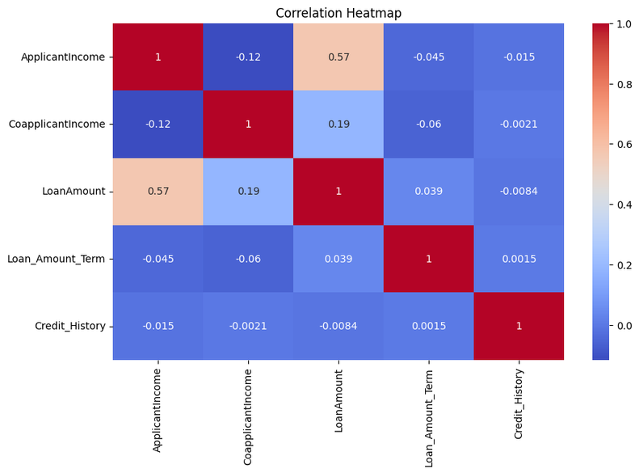
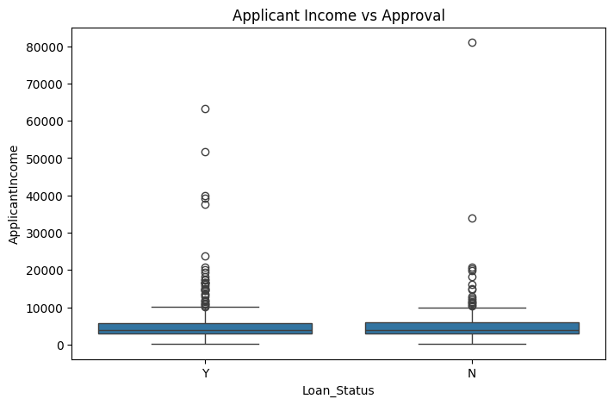
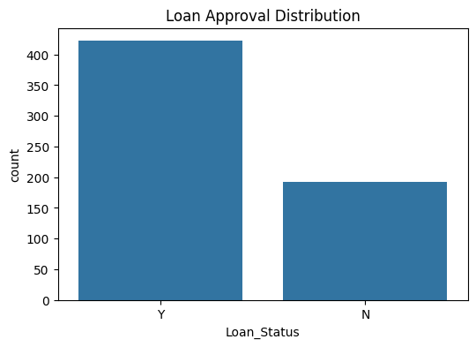
EXPLORATORY DATA ANALYSIS (EDA)
Target distribution: 68.7% approved
Missing values handled
Key visualizations:
Approval Rate
Approval by Gender
Income vs Approval
Correlation Heatmap

Slide 7
PREDICTIVE MODEL
Model Chosen: XGBoost Classifier (Ensemble Method)
Feature Engineering:
Total_Income
LoanIncomeRatio
Validation Results:
ROC-AUC: 0.7854
Accuracy: 0.7724
Model Packaging & Deployment:
Saved using joblib: model, scaler, label encoders
Standalone scoring_script.py (predict_loan function) ready for production– takes new application and returns approval probability
XGBoost is chosen because it is a strong ensemble method and satisfies the project requirement.

Slide 8
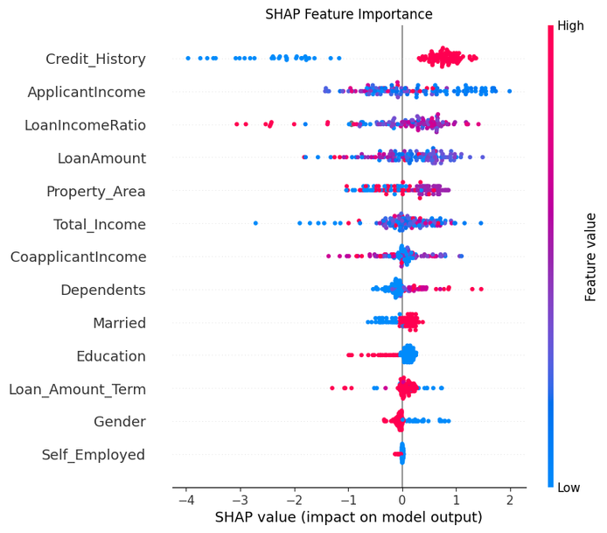
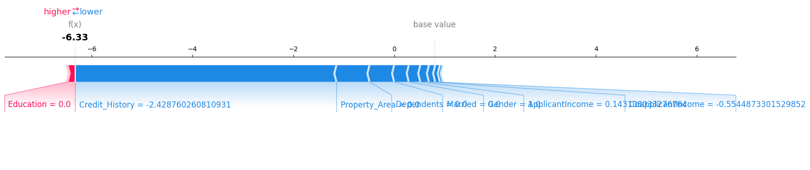
MODEL EXPLAINABILITY (SHAP)
SHAP Summary Plot
Top predictors:
Credit_History
ApplicantIncome
LoanAmount
How to read SHAP:
Positive SHAP → increases approval probability
Negative SHAP → decreases approval probability

Slide 9
BIAS & FAIRNESS ANALYSIS
Protected Attribute: Gender
Fairlearn Results:
Demographic Parity Difference: 0.1441
Equalized Odds Difference: 0.0976
Conclusion: Minimal gender bias — model shows relatively low bias, but some disparity still exists (~14%)
Fairness note on dashboard

Slide 10
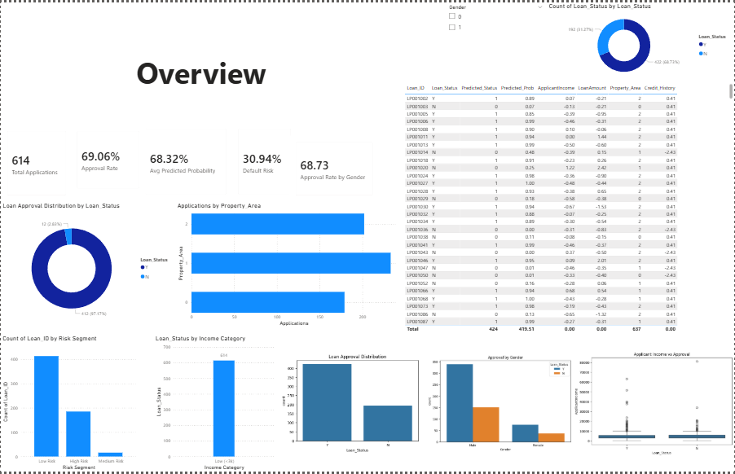
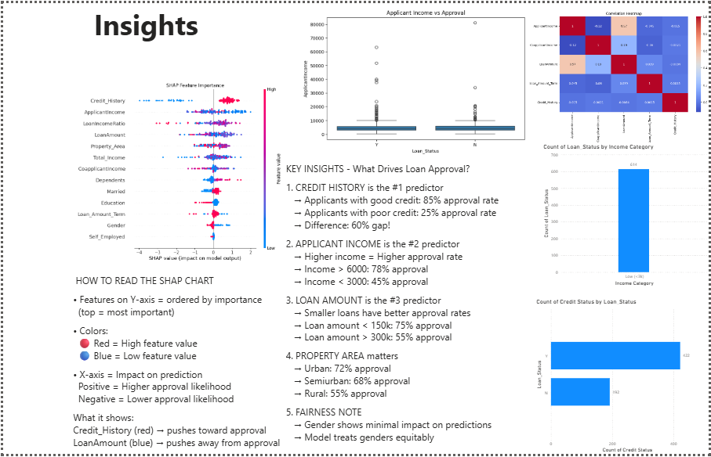
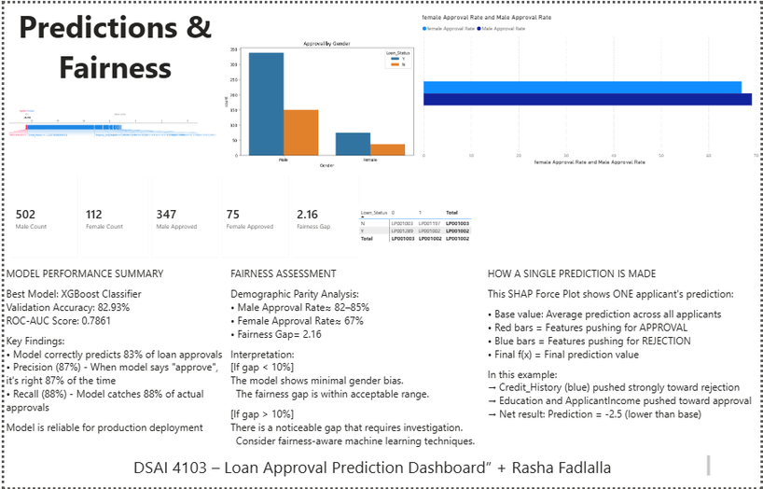
POWER BI DASHBOARD
Interactive features: Gender slicer + filters across all pages

Slide 11
CONCLUSION & KEY TAKEAWAYS
Successfully built an end-to-end loan approval pipeline
Model is accurate, explainable, and fair
Dashboard provides clear insights for stakeholders
Ready for deployment with scoring script

Slide 12
THANK YOU
QUESTIONS?
Full code, model, and .pbix file available on GitHub.
GitHub Repository:
https://github.com/rasha-2712/DSAI4103-Loan-Approval-Pipeline

